Slide 1
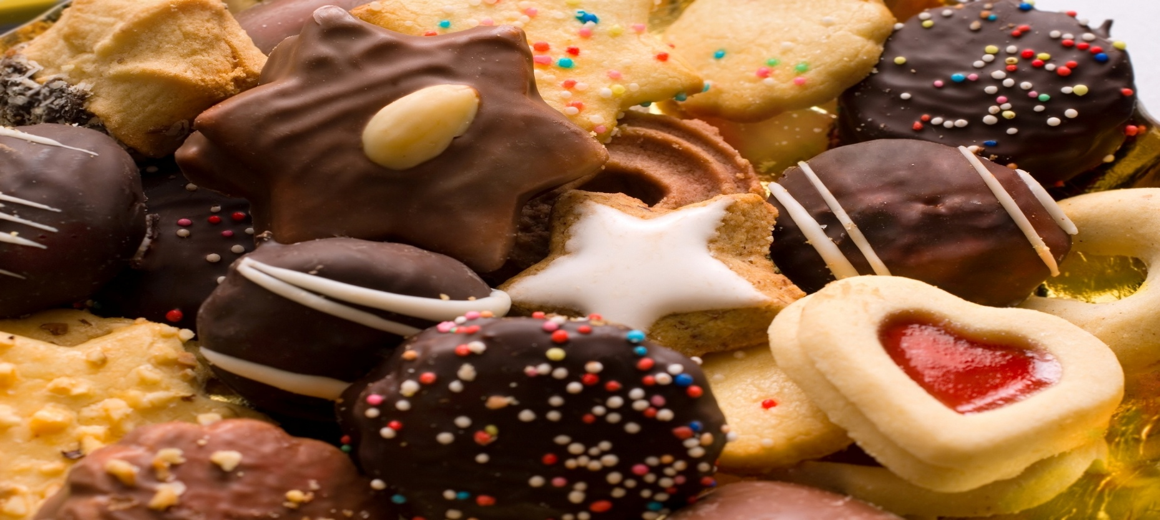
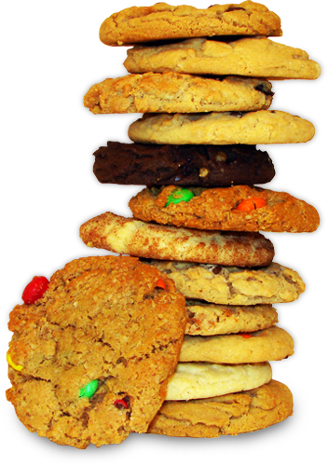
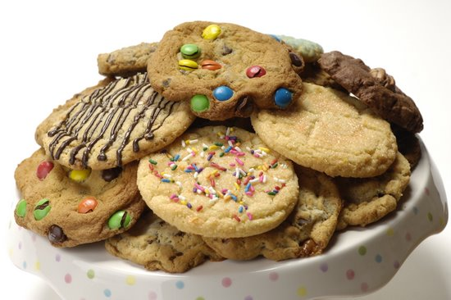
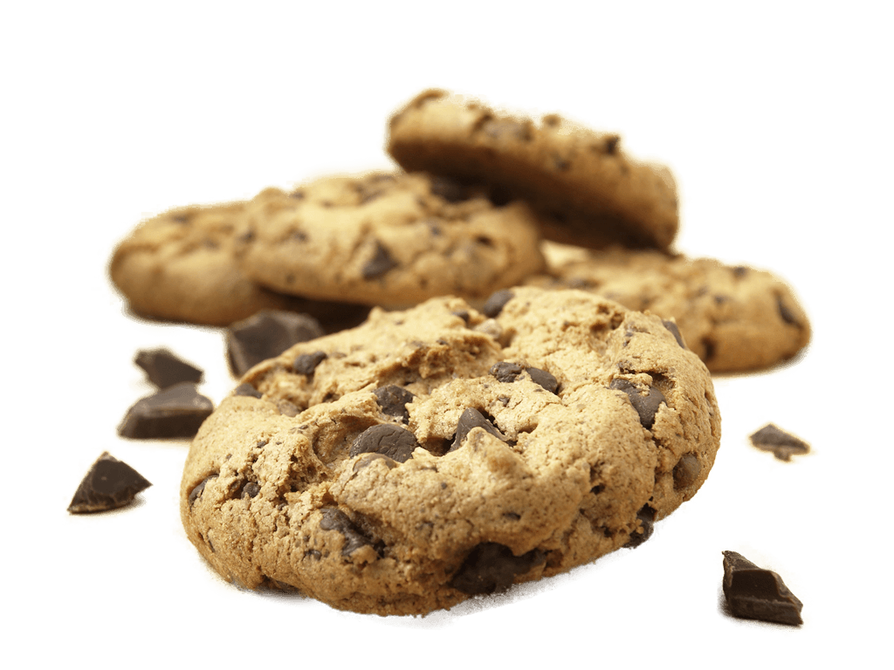
Notes:
5/6/20
1
1

Slide 2
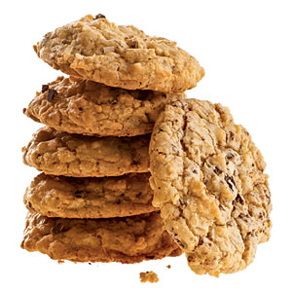
Cookies come in all shapes and sizes ranging from small cookies served with tea to oversized cookies that are a dessert all by themselves
They come in a variety of flavors and textures. Some are sweet and crisp while others may be buttery with a soft chewy texture
Knowing how various ingredients and methods influence the characteristics of a cookie is important when trying to achieve a particular finished product.
Notes:
5/6/20
2
2

Slide 3
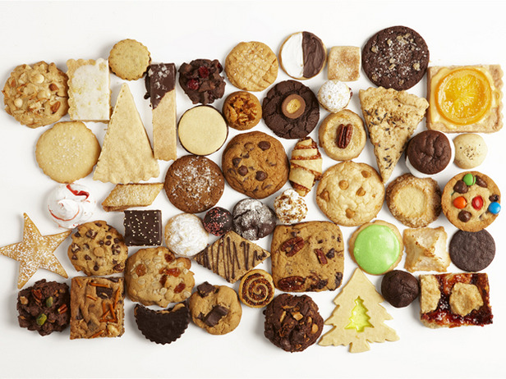
The flavor of cookies is primarily determined by the quality of the ingredients that make up the dough.
Proper proportion of ingredients is also essential. Therefore, follow recipes carefully and measure ingredients exactly.
Notes:
5/6/20
3
3

Slide 4
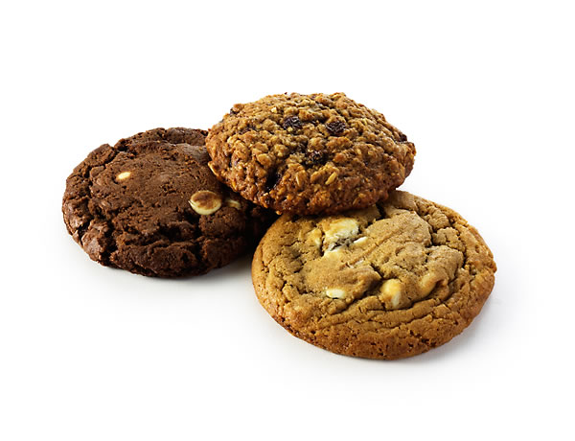
Choosing high-gluten flour can make cookies tough.
Crisper cookies have a larger proportion of sugar.
Softer cookies contain more fat and moisture.
Chewy cookies get their texture from a higher amount of sugar combined with moisture, as well as more eggs.
Notes:
5/6/20
4
4

Slide 5
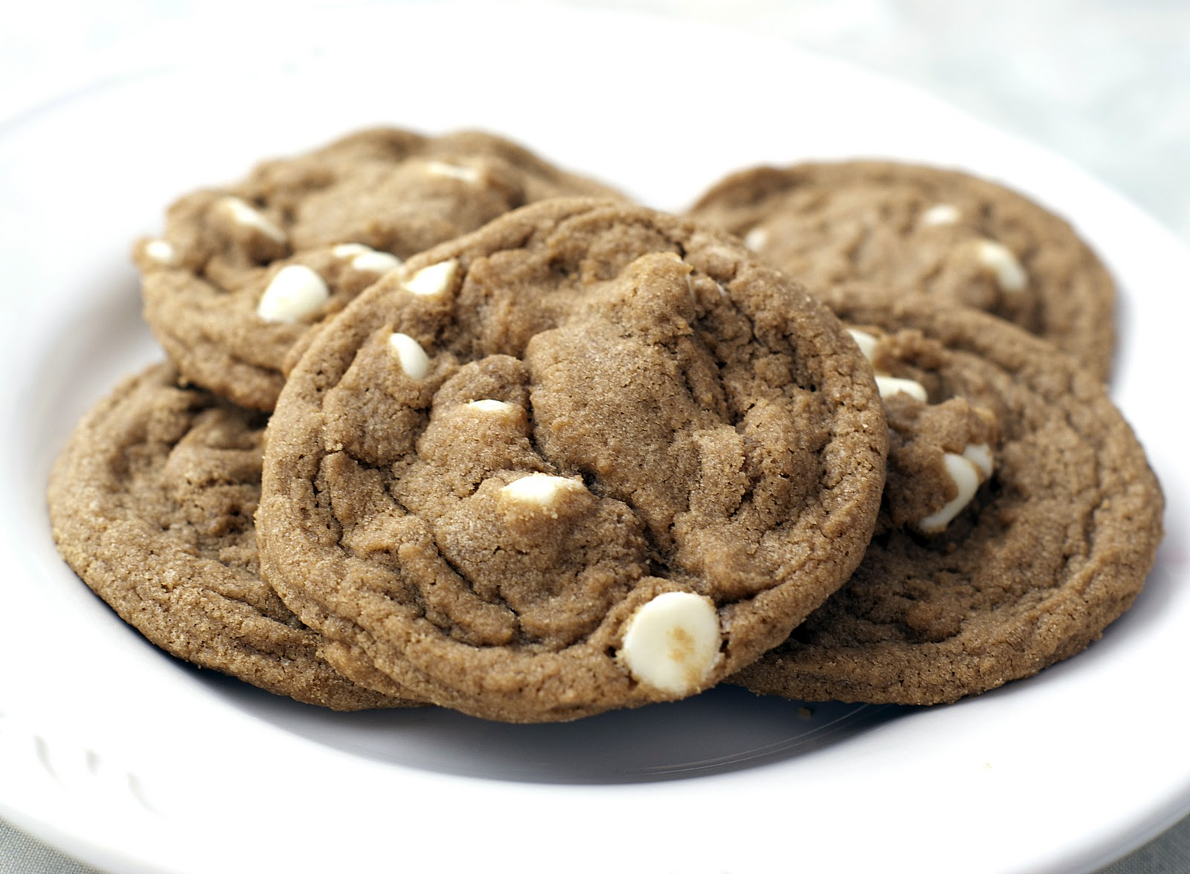
Mixing and baking procedures also affect a cookie’s texture.
Over-mixing the dough will develop too much gluten creating a tough finished product.
Baking too long or at a temperature that is too high usually results in a dry, hard cookie.
Notes:
5/6/20
5
5

Slide 6
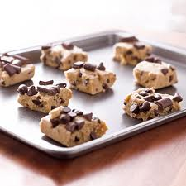
Shaping raw dough so the end product has a pleasing, attractive appearance is an important step for creating a quality cookie.
Ensuring that the shape is uniform for all the cookies is key.
The portioning of the dough
must also be consistent so the cookies are the same size.
Notes:
5/6/20
6
6

Slide 7
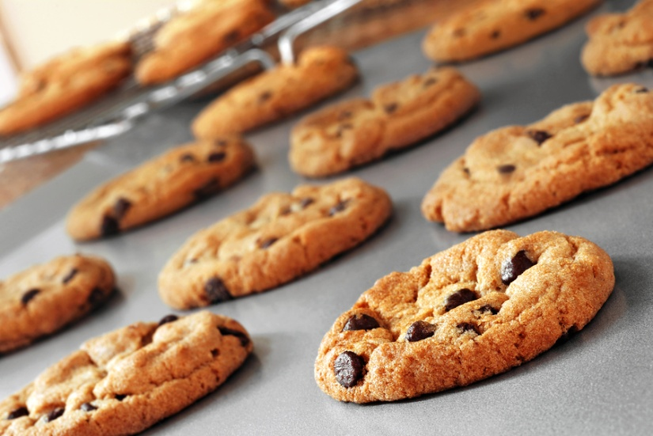
Baking at the proper temperature and for the proper length of time is essential for proper color. This also ensures that the dough spreads properly
Remove cookies from the oven when the bottoms and edges turn golden brown. Allow them to firm up slightly before removing them from the pan to avoid tearing or breaking the cookies.
Notes:
5/6/20
7
7

Slide 8
 | Undermixed | Overmixed | Too much sugar | Lack of sugar | Too much fat | Lack of fat | Too much liquid | Lack of liquid | Baking temperature too high | Baking temperature too low
Spreads too much | o |  | o |  |  |  |  |  |  | o
Spreads too little |  | o |  | o |  |  |  |  | o
Too soft | o |  |  |  | o |  | o
Tough/hard |  | o | o | o |  | o |  | o
Crumbles | o |  | o |  | o
Pale Color |  |  |  | o |  |  |  |  |  | o
Dark Color |  |  |  |  | o |  |  |  | o
Notes:
5/6/20
8
8

Slide 9
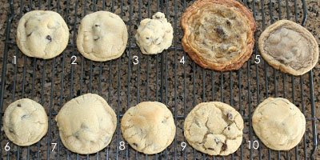
Notes:
9
5/6/20
9
9
1. This cookie is done just right. It is pictured to compare with the rest. 2. This dough was not refrigerated. It is still good but a little flatter than it should be. 3. This dough contained too much flour and did not spread much at all. It is interesting to note that the dough looked identical to the correct dough, but was much stiffer and drier. 4. This dough had too little flour. It spread too much and didn’t bake evenly. 5. This dough was over-mixed. It had a poor color, baked flat and had a strange consistency. 6. This dough was formed too small. It was overcooked at eight minutes. It is fine to make smaller cookies, just bake them for less time. 7. This dough was formed too large. The outsides were done while the middle was too high and underdone. 8. This dough was baked in an oven 25 degrees too hot. The outside was overdone and the inside was slightly underdone. 9. This dough was baked in an oven 25 degrees too cool. It fell flat and became too crisp without much of an inside. 10. This dough was frozen when baked. It took longer to bake and didn’t cook as evenly. To use frozen dough, set on cookie sheet at room temperature while oven is preheating, 15-20 minutes. It takes the frost off and bakes perfectly.

Slide 10
Cookie Problems.....
Notes:
5/6/20
10
10

Slide 11
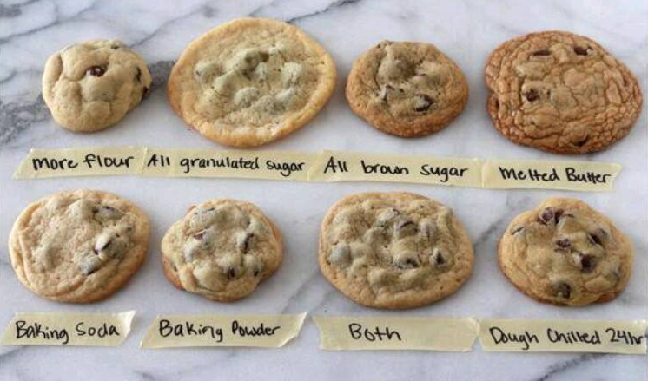
Notes:
5/6/20
11
11

Slide 12
Notes:
5/6/20
12
12

Slide 13
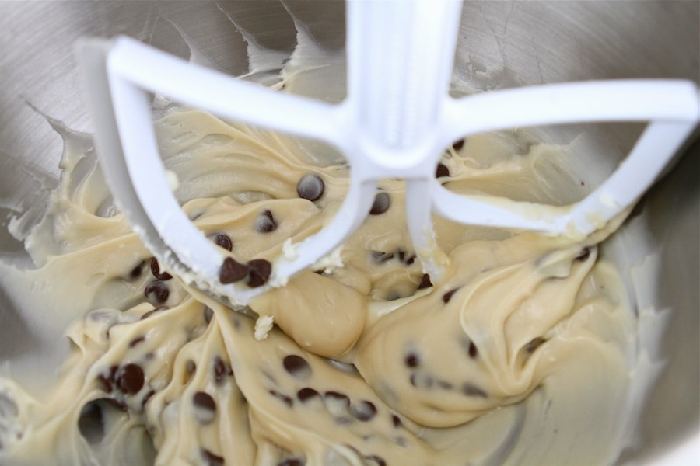
How easy cookies are to make becomes clear when you learn the methods for mixing cookie dough.
There are two common methods for making cookie dough—the one-stage method and creaming method.
Both methods are done with an electric mixer using the paddle attachment.
Notes:
5/6/20
13
13

Slide 14
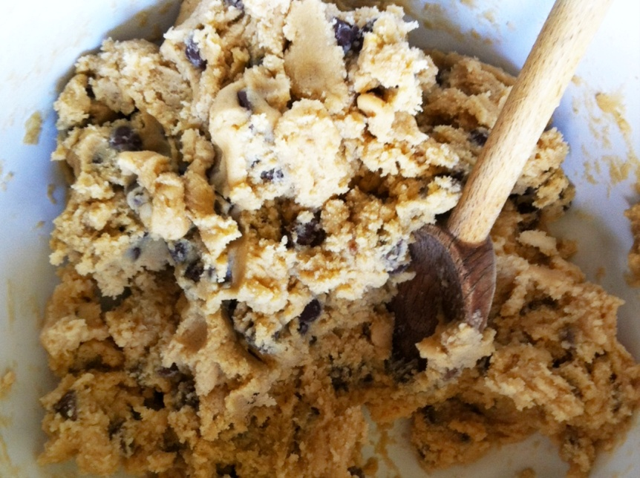
The one-stage method is the simplest way to make cookie dough.
You place all the ingredients into the bowl and mix.
Allow two to three minutes at moderate speed to fully blend all the ingredients.
Overmixing can result in tough dough.
Notes:
5/6/20
14
14

Slide 15
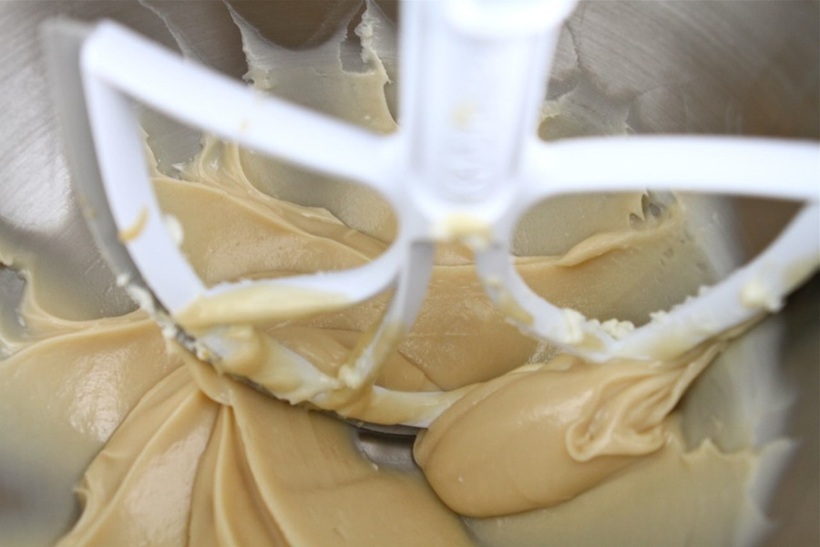
The first step in the creaming method is to mix the butter or shortening with the sugar and spices until smooth.
Next, eggs and liquids are added and mixed until incorporated.
Finally, the flour and leavening agent are added and blended. Since the flour is added last, gluten is less likely to overdevelop using this method.
Notes:
5/6/20
15
15

Slide 16
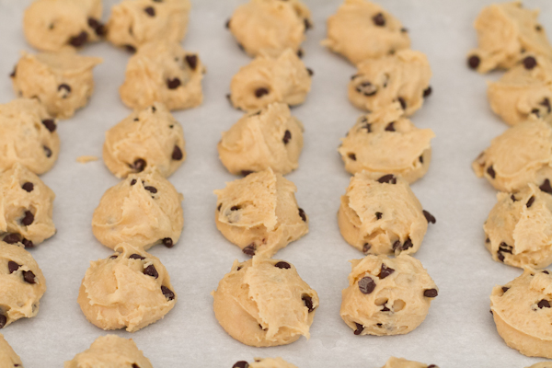
Cookies can be classified by the method used to form the cookie.
Each technique creates a uniquely shaped cookie.
Notes:
5/6/20
16
16

Slide 17
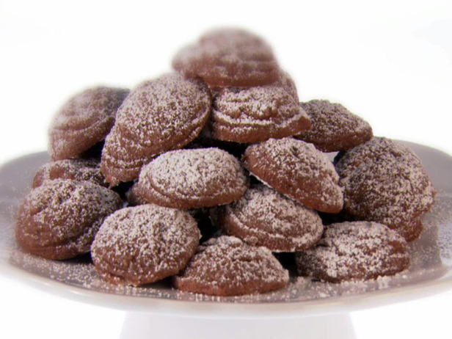
Drop cookies are the easiest and most common method of forming cookies.
They are made by dropping small amounts of dough onto a sheet pan.
A portion scoop (disher) is a good tool for creating equal- sized cookies.
Notes:
5/6/20
17
17

Slide 18
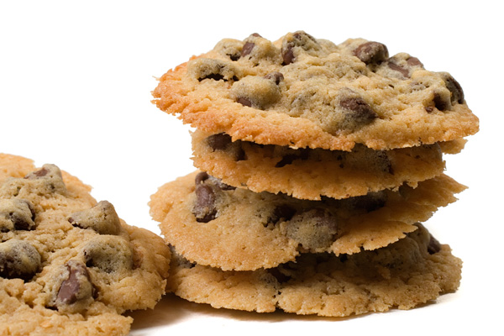
During baking, the small mounds of dough spread into flat cookies.
When portioning drop cookies, allow enough space between the drops of dough to allow the cookies to spread during baking.
Chocolate chip and oatmeal cookies are often made using the drop method.
Notes:
18
5/6/20
18
18

Slide 19
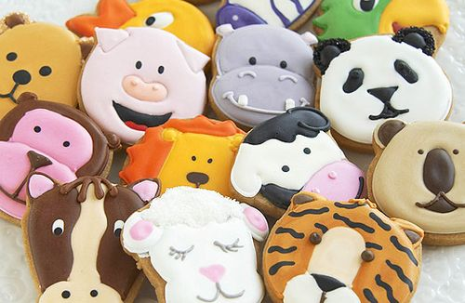
To make rolled cookies, cookie dough is rolled out into a thin sheet and a cutter is used to cut cookies into desired shape.
The cut cookies are transferred to a sheet pan and baked.
The sugar cookie is a popular rolled cookie.
Notes:
5/6/20
19
19

Slide 20
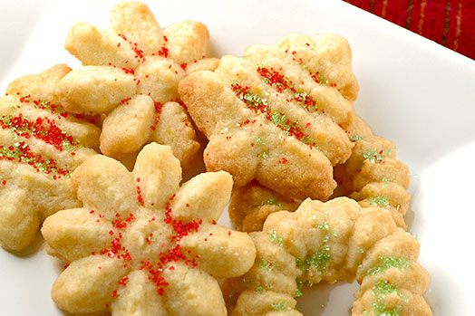
Spritz cookies are made from soft cookie dough that is forced through a pastry bag to form shapes such as rosettes,
shells and scrolls.
Some bakeshops use a special cookie press to make these cookies. The dough is pressed through a specially shaped die to create specific shapes.
Notes:
5/6/20
20
20

Slide 21
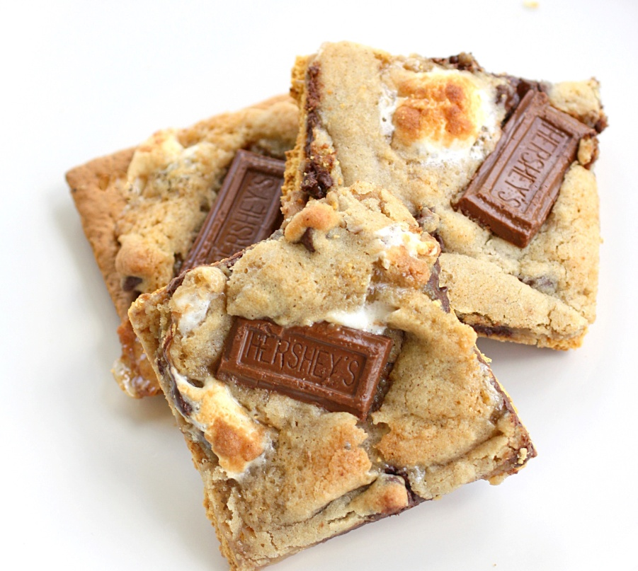
Sheet cookies are made by evenly spreading dough or batter onto a sheet pan.
The entire sheet pan is baked and later the sheet is cut into individual cookies.
Brownies are popular sheet cookies
This method of forming cookies has the advantage of saving labor.
Notes:
5/6/20
21
21

Slide 22
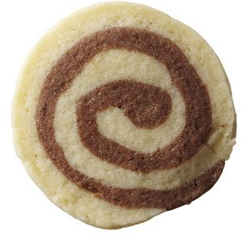
Icebox cookies are made by forming cookies dough into a log, square, triangle, or other shape while the dough is still soft.
The shaped dough is wrapped in plastic wrap or parchment paper and refrigerated.
When fully chilled, the dough is firm and can be sliced into individual cookies.
Notes:
5/6/20
22
22

Slide 23
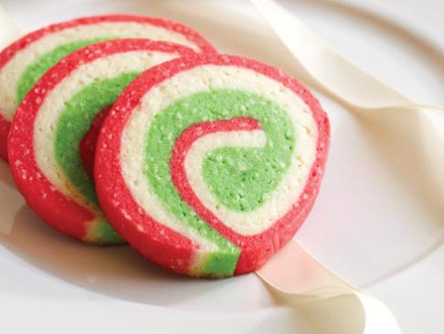
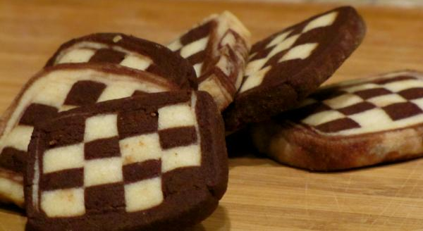
Each slice of dough is laid out on a sheet pan and baked to create individual cookies.
This technique makes it possible to create effect such as checkerboard or pinwheels by forming logs using different colors dough.
Notes:
5/6/20
23
23

Slide 24
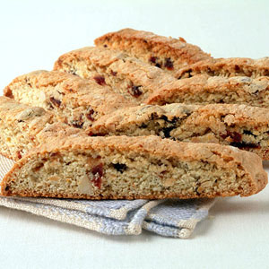
Bar cookies are made by portioning cookie dough into approximate one-pound batches and forming it into a log about the length of a sheet pan.
The log is flattened and baked. Once the log has cooked and while it is still warm, it is sliced into one-inch segments to form cookies. These cookies are baked a second time to create a hard texture.
Biscotti are an example of popular bar cookies.
Notes:
5/6/20
24
24

