Slide 1
Table setting and etiquette

Slide 2
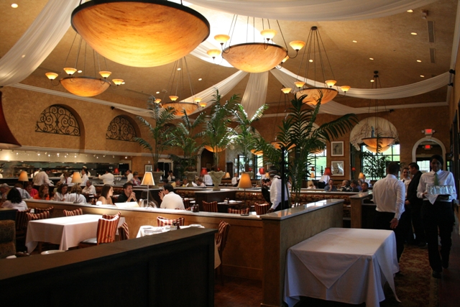
Table Setting
The way you set your
table is important
because it influences:
The appearance of
the food
Atmosphere: tone or feeling of the room
Makes people feel important
Restaurants create an atmosphere by the way they set the table.

Slide 4
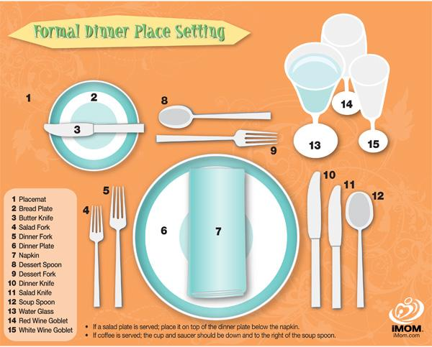

Slide 5
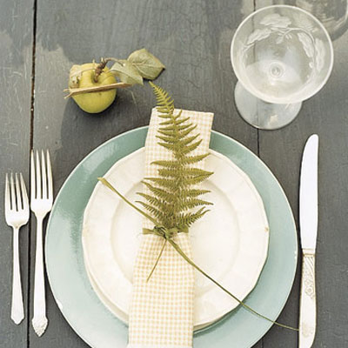
Components of setting A Table
Linens: protect table top, provide comfort, beauty
Flatware: eating utensils, a variety for different types of food.
Dinnerware: displays food,
comes in a variety of shapes
and sizes for different parts
of the meal.
Glassware: for all beverages,
hot or cold

Slide 6
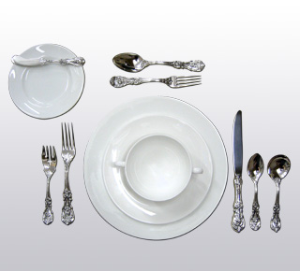
Flatware
Flatware in order of use from the outside in
Forks and napkin to the left of plate
Knives and spoons to the right of plate
Bottoms of each flatware piece should be in line with bottom of plate
Tines of fork and bowl of spoon turned upward
Blade of knife turned toward edge of plate

Slide 7
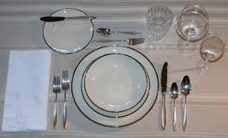
Dinnerware
Dinner plate should be the center of the cover 1” from tables edge.
Bread and butter plate and salad plate above the fork
Salad plate above the napkin , or it can be placed on the plate

Slide 8
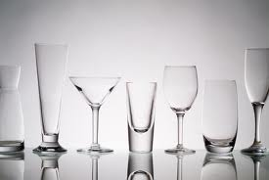
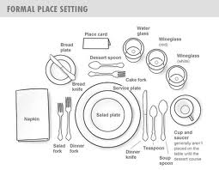
Glasswaree placement
Water glass just above the tip of
the knife
Place other glasses below and to the right of water glass
Cup and saucer to the right side of knife and spoon

Slide 9
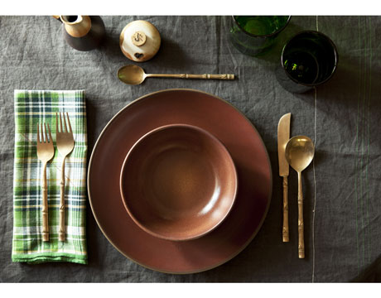
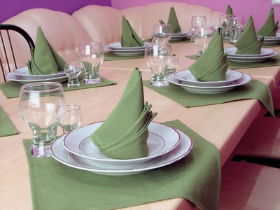
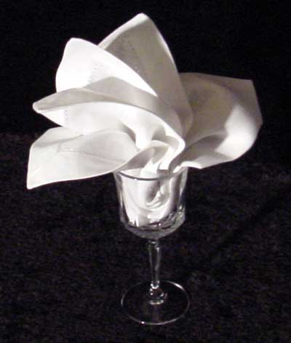
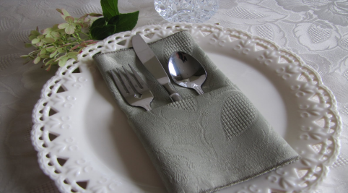
Napkin Placement
General Rule: place to the left
of the forks or on the service
plate.
Can be placed for aesthetics or use.
Place the napkin on your lap to begin eating, place on chair if you leave and return, place to the left of the plate when finished.

Slide 10
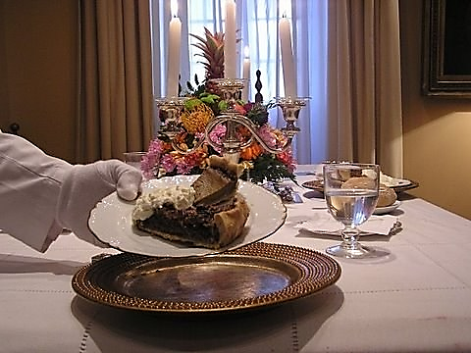
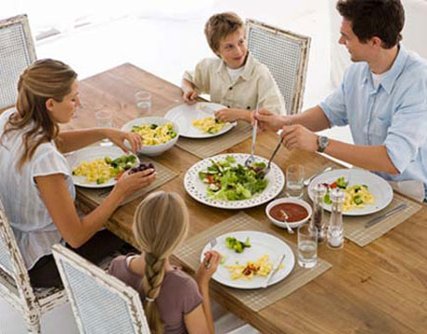
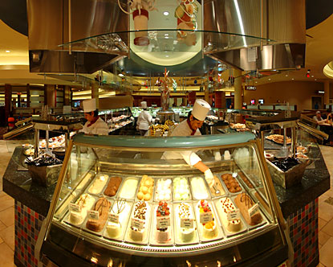
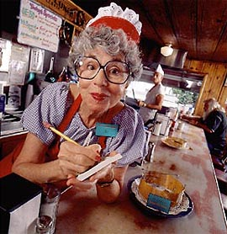
Types of table service
Plate service
Plates are filled in the kitchen and brought to you
Family service
Dishes of food are brought to table for self service
Modified English service
Dishes of food brought to the table, then served to your plate
Buffet
Guests help themselves to a display of food
Formal
Someone waits on and serves guests

Slide 11
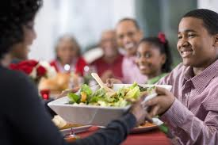
Passing Food
Pass food to the…
right

Slide 12
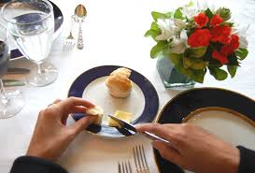
Eating Rolls
Take a piece of the roll, butter and eat, only one piece at a time

Slide 13
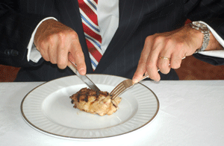
Eating Meat
Cut and eat only 1-2 pieces at a time

Slide 14
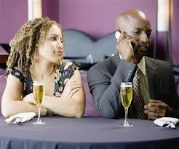
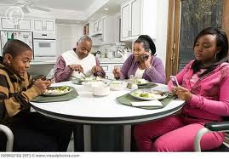
No Cell phones at the table!

Slide 15
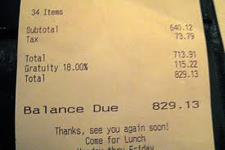
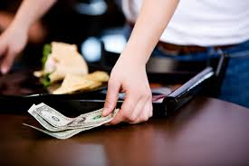
Tipping
15-20% of the total bill
Tip off original price, even if you have coupons/discounts!
Waiters only make $2.15/hour!
Gratuity –the tip is added to the bill (large parties)

Slide 16
Basic rules for table courtesy
Sit down at left side of chair
Use flatware from the outside in
Cover mouth when coughing/sneezing
Don’t talk with your mouth full
Sit up straight and keep elbow off the table
It’s alright to start eating when everyone has been served
If you are not sure what to do, follow the actions of the host/hostess

Slide 17
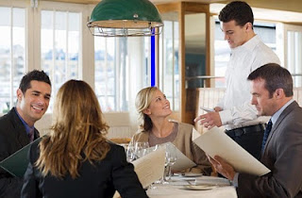
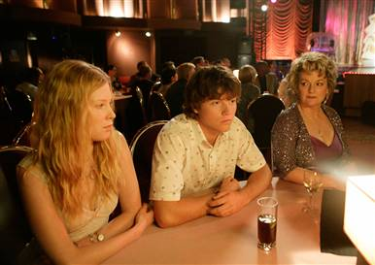
Etiquette
the customary code of polite behavior in society or among members of a particular profession or group.
Good manners is making others feel comfortable
Not just a list of do’s and don'ts.

